Slide 1

INFORMATION RETRIEVAL
SYSTEM FROM IMAGES DATABASE
Team members:
Arpit Kumar
Ashutosh Mishra
B.Vijay Kumar Kakra
Basava Chetan
Dheeraj Kumar

Slide 2
Under the guidance of
Dr. Rajesh T M

Slide 3
Libraries used:
opencv
face recognition
os
datetime
numpy

Slide 4
Opencv:
OpenCV-Python is a library of Python bindings designed to solve computer vision problems.
Os:
The OS module in python provides functions for interacting with the operating system.
datetime:
Datetime module supplies classes to work with date and time. These classes provide a number of functions to deal with dates, times and time intervals.
numpy:
NumPy is a python library used for working with arrays.

Slide 5
Face Detection:
First, look at a picture and find all the faces in it
Second, focus on each face and be able to understand that even if a face is turned in a weird direction or in bad lighting, it is still the same person.
Third, be able to pick out unique features of the face that you can use to tell it apart from other people— like how big the eyes are, how long the face is, etc.
Finally, compare the unique features of that face to all the people you already know to determine the person’s name.

Slide 6
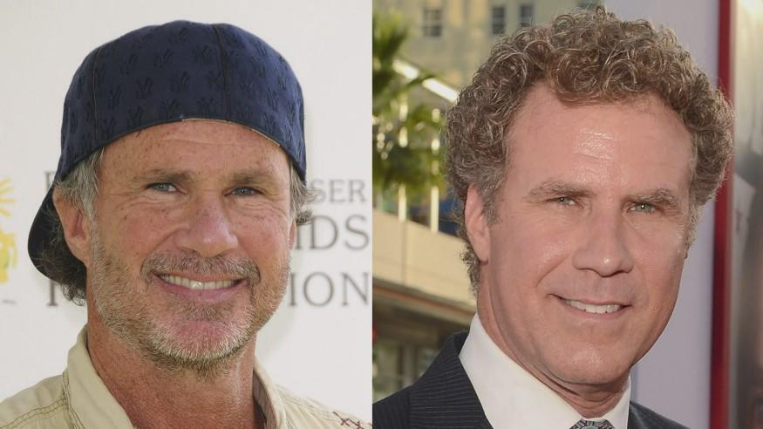
As a human, your brain is wired to do all of this automatically and instantly. In fact, humans are too good at recognizing faces and end up seeing faces in everyday objects.
Computers are not capable of this kind of high-level generalization (at least not yet…), so we have to teach them how to do each step in this process separately.
We need to build a pipeline where we solve each step of face recognition separately and pass the result of the current step to the next step.
In other words,we will chain together several machine learning algorithms.

Slide 7
Face Recognition - by computers:
Steps to be followed are:
Step 1: Finding all the Faces
Step 2: Posing and Projecting Faces
Step 3: Encoding Faces
Step 4: Finding the person’s name from the encoding

Slide 8
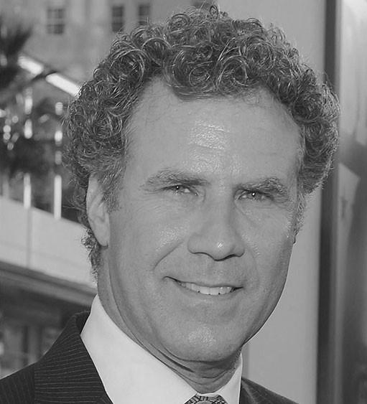
1.Finding all faces:
The first step in our pipeline is face detection.
We’re going to use a method invented in 2005 called Histogram of Oriented Gradients — or just HOG for short to detect the faces.
To find faces in an image, we’ll start by making our image black and white because we don’t need color data to find faces.

Slide 9
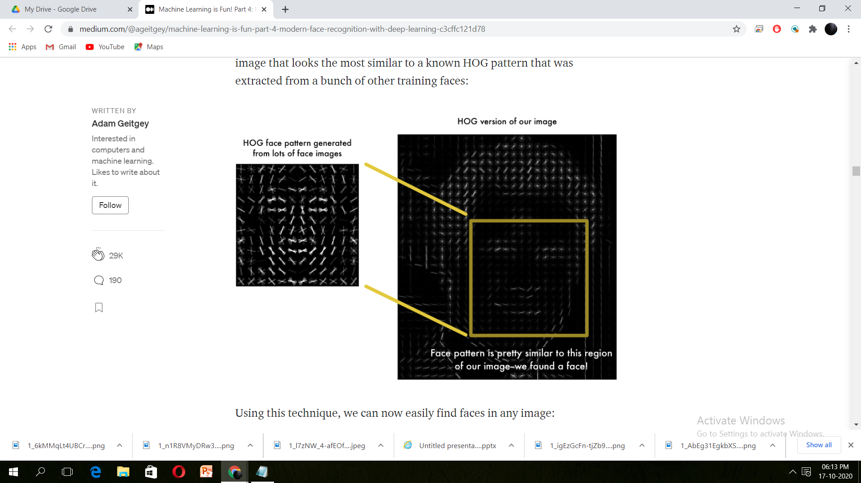
To find faces in this HOG image, all we have to do is find the part of our image that looks the most similar to a known HOG pattern that was extracted from a bunch of other training faces.

Slide 10
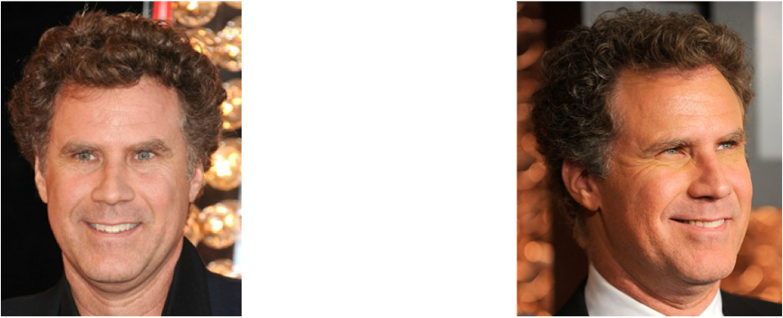
Step 2: Posing and Projecting Faces:
Now, we have detected the faces in our image.But now we have to deal with the problem that faces turned different direction look totally different to a computer.
To account for this, we will try to warp each picture so that the eyes and lips are always in the sample place in the image.
This will make it a lot easier for us to compare faces in the next steps.

Slide 11

To do this , we can use an algorithm called “face landmark estimation”.
The basic idea is we will come up with 68 specific points(called landmarks) that exist on every face - the top of the chin,the outside edge of each eye,the inner edge of each eye brow,etc.
Then we can train a machine learning algorithm to be able to find these 68 specific points on any face.

Slide 12
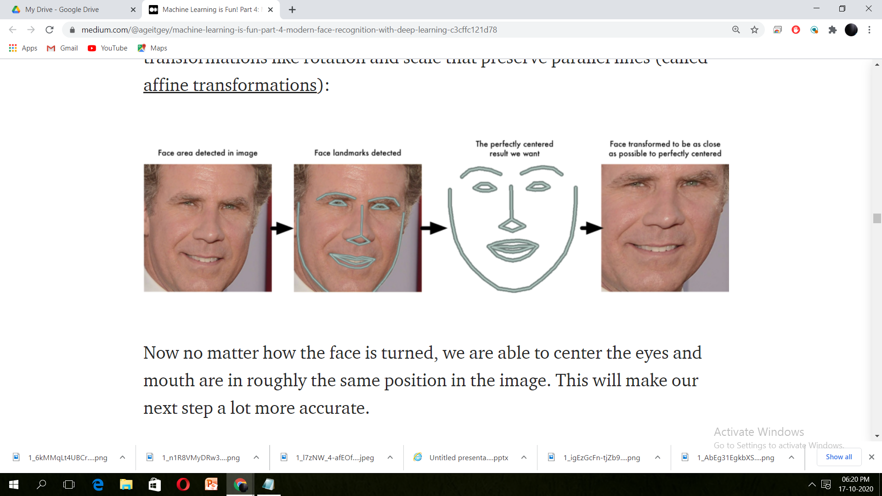
Now that we know where the mouth and eyes are, we will simply rotate, scale and shear the image so that the eyes and mouth are centered as best as possible.
Now no matter how the face is turned we are able to center the eyes and mouth are in roughly the same position in the image.

Slide 13
Step 3: Encoding faces:
This is actually telling faces apart.
In order to do this we extract a few basic measurements from each face. Then we could measure our unknown face the same way and find the known face with the closest measurements.
For example, we might measure the size of each ear, the spacing between the eyes, the length of the nose, etc.
The solution is to train a Deep Convolutional Neural Network .
But instead of training the network to recognize pictures objects like we did last time, we are going to train it to generate 128 measurements for each face.

Slide 14
The training process works by looking at 3 face images at a time:
Load a training face image of a known person.
Load another picture of the same known person.
Load a picture of a totally different person.
Then the algorithm looks at the measurements it is currently generating for each of those three images. It then tweaks the neural network slightly so that it makes sure the measurements it generates for #1 and #2 are slightly closer while making sure the measurements for #2 and #3 are slightly further apart.

Slide 15
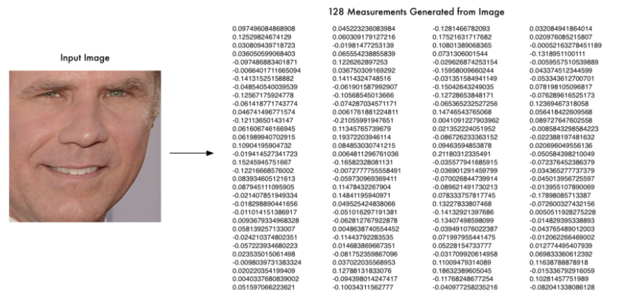
After repeating this step millions of times for millions of images of thousand of different people,the neural network learns to reliably generate 128 measurements for each person.Any ten different pictures of the same person should give you roughly the same measurement.

Slide 16
Step 4: Finding the person’s name from the encoding:
All we have to do is find the person in our database of known people who has the closest measurements to our test image.
We’ll use a simple linear SVM classifier.
We have to train a classifier that can take in the measurements from a new test image and tells which known person is the closest match.
Running this classifier takes milliseconds. The result of the classifier is the name of the person.
Finally we store this name into an excel sheet.

Slide 17
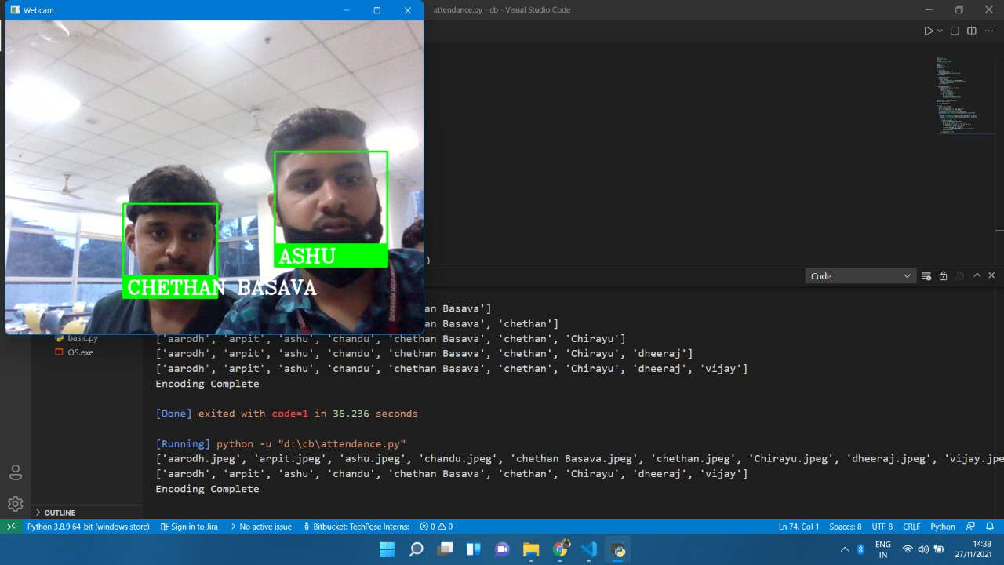
Result

Slide 18
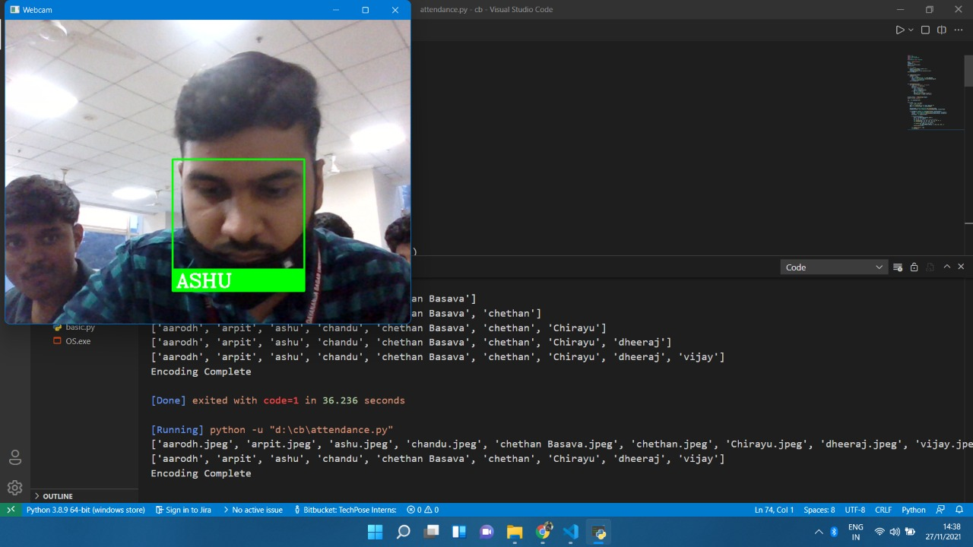

Slide 19
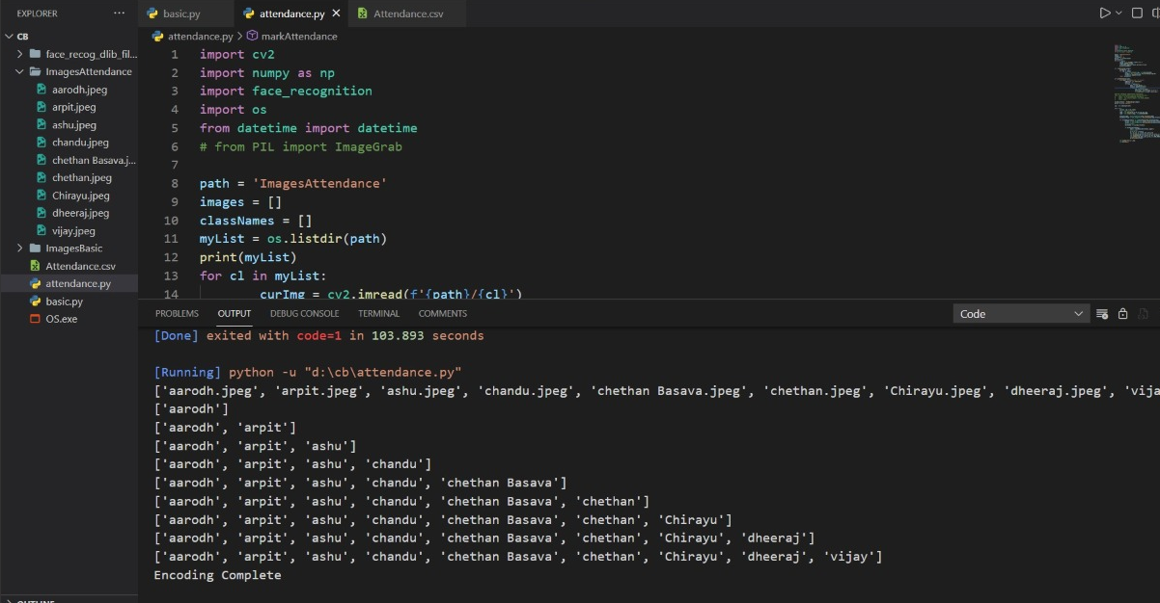

Slide 20
Conclusion
This system helps to avoid the fail proof of attendance system and this system works as the substitute for the all existing systems i.e. Radio Frequency Identification and all other biometric systems. It saves the time and energy in the aspect of taking attendance. Automated Attendance Systems based on face recognition techniques thus proved to be time saving and secured. This system can also be used to identify an unknown person whether he is related to the organization or not.

Slide 21
Thank you

